Slide 1
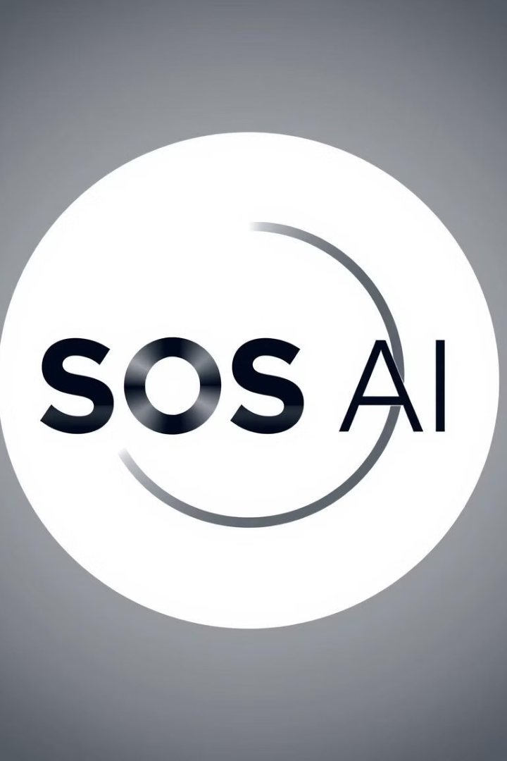

SOS AI for Mental and Disabled Person
SOS AI is an innovative project that leverages the power of artificial intelligence to provide empathetic support for individuals struggling with mental health challenges and disabilities. By combining advanced technology with a deep understanding of human needs, SOS AI aims to revolutionize the way we approach mental health and disability support.
by Divjot Singh Arora

Slide 2

Empathetic AI for Mental Health and Disability Support
1
Personalized Support
2
Emotional Intelligence
SOS AI adapts to the unique needs and preferences of each user, providing tailored solutions to address their specific challenges.
The AI system is trained to recognize and respond to human emotions, offering a compassionate and understanding approach to mental health and disability support.
3
Accessibility
SOS AI is designed to be accessible to people of all abilities, ensuring that everyone can benefit from its features and functionalities.

Slide 3
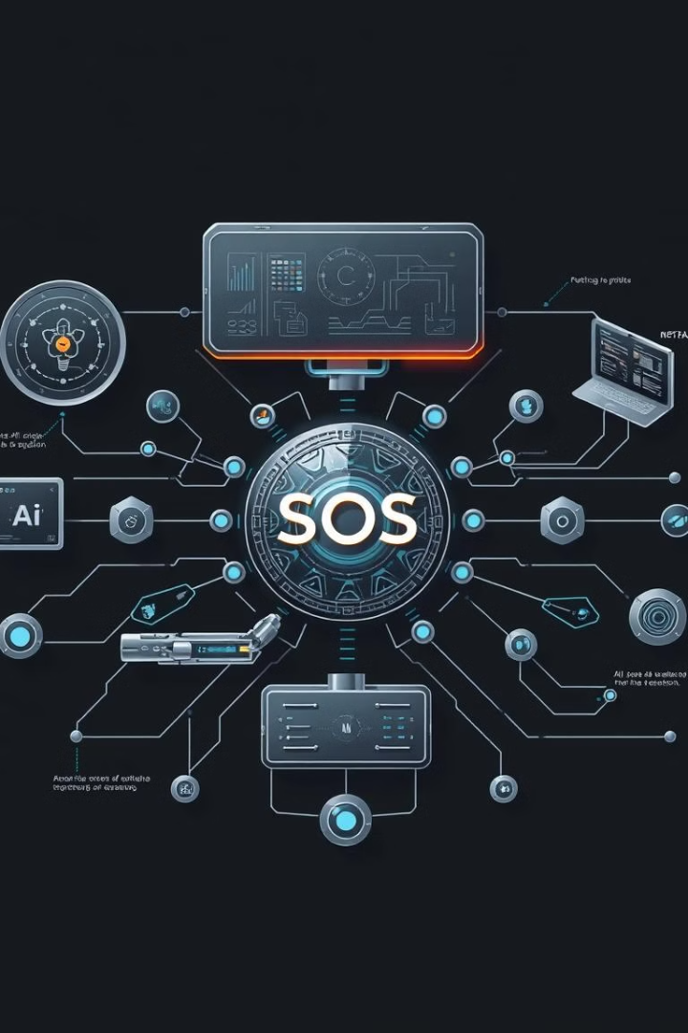
Overview of the SOS AI Project
1
Assessment
SOS AI starts by conducting a comprehensive assessment of the user's needs, preferences, and challenges through interactive questionnaires and conversations.
2
Personalized Plan
Based on the assessment, the AI system creates a personalized plan, tailoring its features and functionalities to the user's specific requirements.
3
Ongoing Support
SOS AI provides continuous support, regularly monitoring the user's progress and adjusting the plan as needed to ensure the most effective and impactful assistance.

Slide 4
The Need for Mental Health and Disability Support
Mental Health Challenges
Disabilities
Barriers to Access
Mental health conditions, such as depression, anxiety, and PTSD, affect millions of individuals worldwide, often leading to significant distress and impairment in daily life.
Disabilities, whether physical, cognitive, or sensory, can pose unique challenges for individuals, requiring specialized support and accommodations to ensure their well-being and independence.
Many people face barriers in accessing the mental health and disability support they need, due to factors like stigma, lack of resources, or geographic isolation.

Slide 5
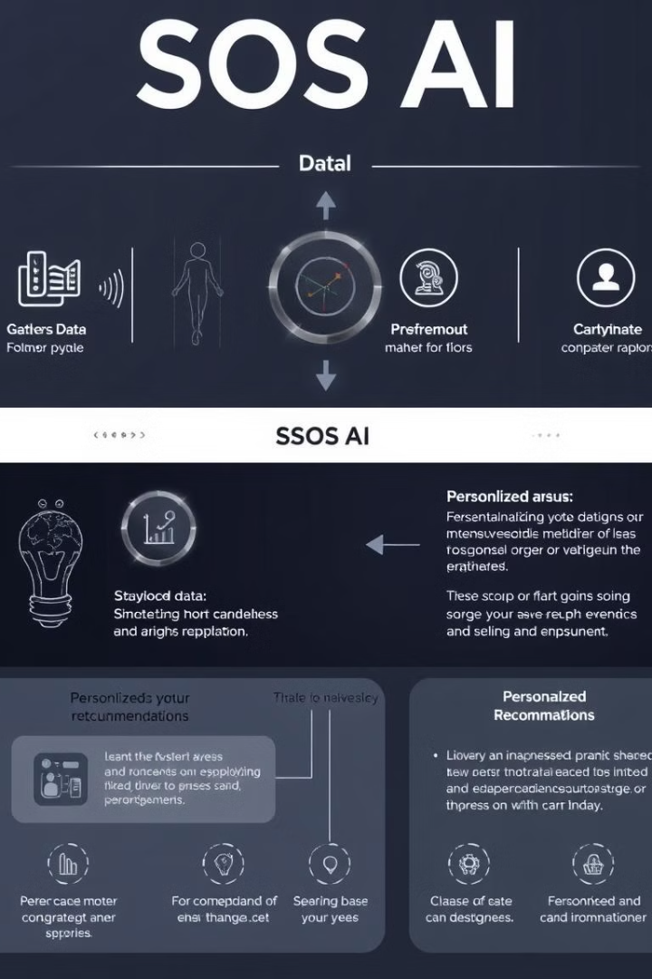



How SOS AI Works
Data Collection
SOS AI collects data from the user through various channels, including interactive questionnaires, voice conversations, and integrated sensors.
AI Analysis
The AI system processes the collected data, using advanced algorithms to identify patterns, recognize emotional states, and develop personalized insights.
Tailored Support
Based on the analysis, SOS AI provides customized recommendations, coping strategies, and support interventions to address the user's specific needs.

Slide 6





Key Features and Functionalities
Conversational Interface
Routine and Goal Tracking
SOS AI offers an intuitive, conversational interface that allows users to communicate their thoughts and feelings in a natural, comfortable way.
The system helps users establish and maintain healthy routines, track their progress, and set achievable goals to support their recovery and growth.
Guided Exercises
Community Support
SOS AI provides users with a library of evidence-based mindfulness, meditation, and relaxation exercises to help manage stress and improve well-being.
The platform connects users with a supportive community of peers, clinicians, and experts, fostering a sense of belonging and shared understanding.

Slide 7

Benefits to Users
Empowered Self-Care
Reduced Isolation
SOS AI empowers users to take an active role in their mental health and disability management, providing them with the tools and support to achieve their goals.
The platform's community features and personalized support help to alleviate feelings of loneliness and isolation, which are common among individuals with mental health or disability challenges.
Improved Outcomes
Increased Independence
Through its data-driven, personalized approach, SOS AI has demonstrated significant improvements in users' mental well-being, symptom management, and overall quality of life.
The AI-powered assistive features of SOS AI help users develop the skills and confidence to live more independently, fostering a greater sense of autonomy and self-reliance.

Slide 8

Future Developments and Roadmap
Expanded Reach
Increase accessibility and availability of SOS AI in underserved communities and global regions.
Multimodal Integration
Integrate SOS AI with wearable devices, smart home technologies, and other digital platforms to provide a more comprehensive and seamless support experience.
Predictive Analytics
Enhance the AI's ability to anticipate user needs and proactively provide personalized interventions, further improving the effectiveness of the platform.
Collaborative Partnerships
Forge strategic partnerships with mental health organizations, disability advocacy groups, and healthcare providers to ensure a holistic and coordinated approach to support.

